Slide 1
Heyi Machinery Components Co., Ltd.
Your reliable partner in China
Almost 20 years experience in the auto braking industry
Copyright @ 2019 Heyi, all right reserved

Slide 2
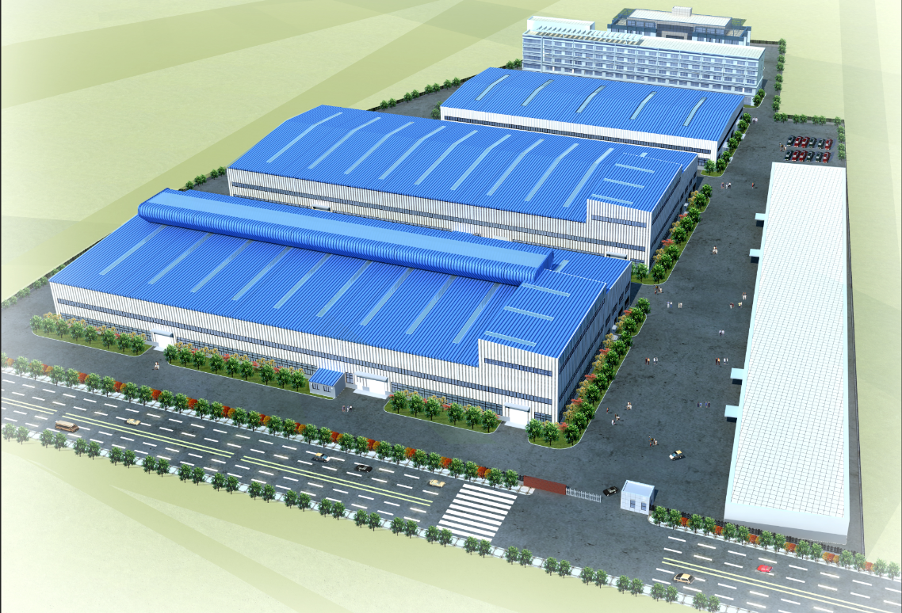
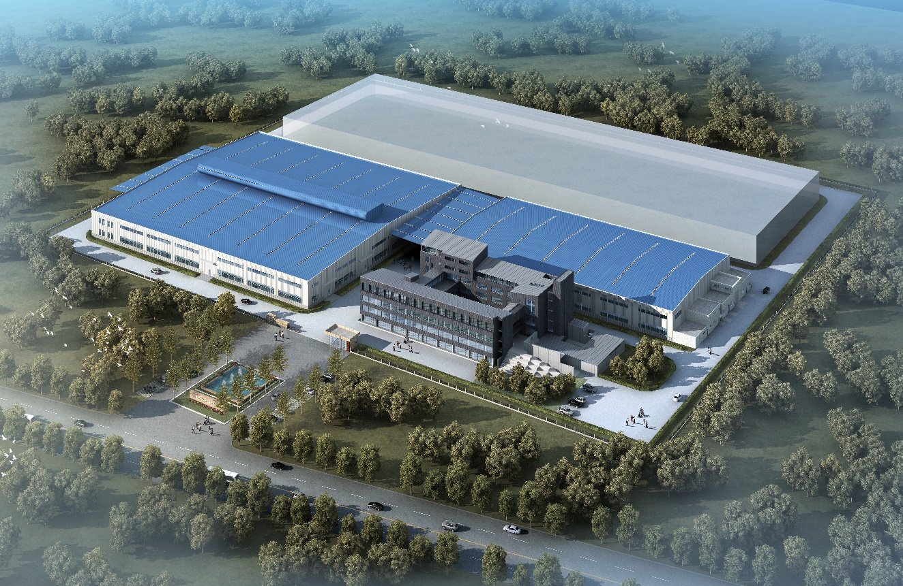
LAYOUT OF WORKSHOPS
Heyi Auto Parts
South Plant Area
Foundry and Rough Machining
North Plant Area
Fine Machining, Painting and Packaging
Copyright @ 2019 Heyi, all right reserved

Slide 3
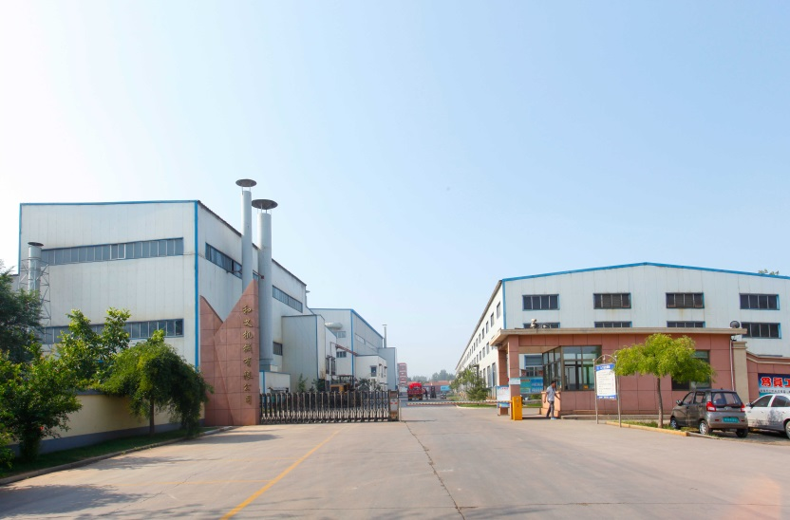
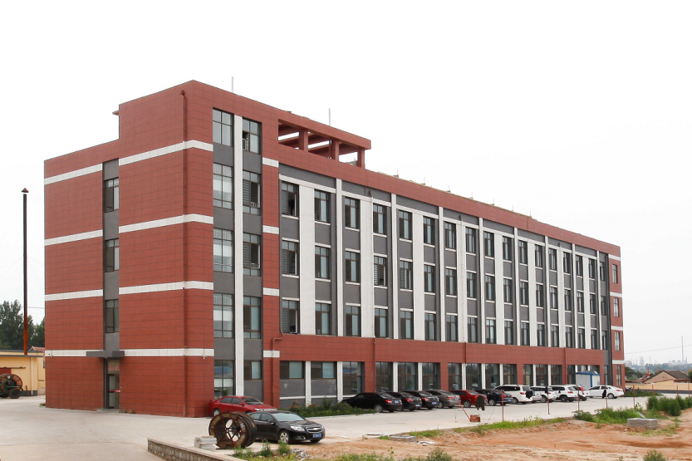
COMPANY PROFILE
Heyi Auto Parts
Heyi Machinery Components Co. Ltd.
Company Start | 1999
Employees | 700 +
Products | PV Discs, Drums & CV Discs
References | 3000 + SKUs
Capacity | 10 Millions
Foundry | 2x4T, 2x6T ABP Furnaces
 | Automated molding line
Machining | 30 production lines.
Sales Area | Europe 65%, N.A.30%
 | and others 5%
Certificates | IATF 16949:2016, ECE R90
Copyright @ 2019 Heyi, all right reserved

Slide 4
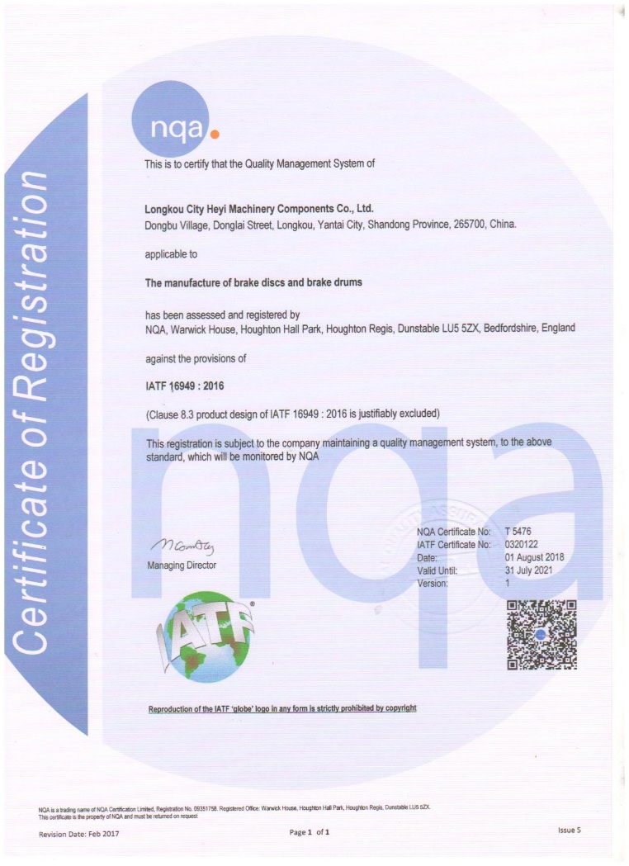
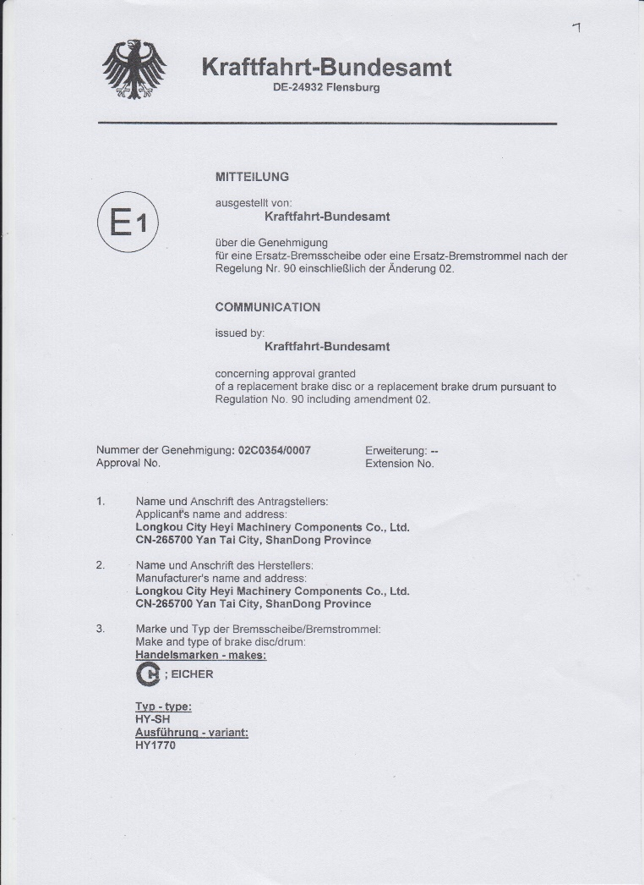
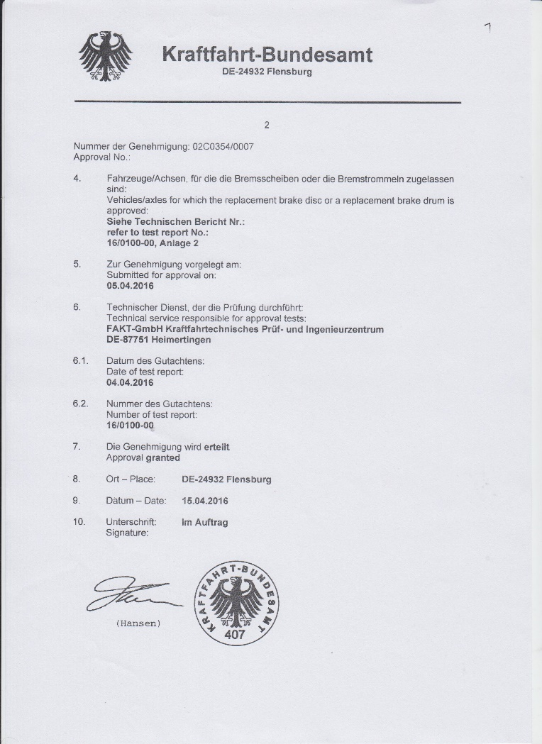
QUALITY CERTIFICATES
Heyi Auto Parts
IATF16949 : 2016
ECE R90 -1 ECE R90 -2
Copyright @ 2019 Heyi, all right reserved

Slide 5
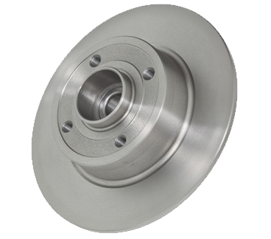
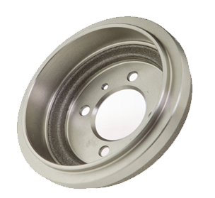
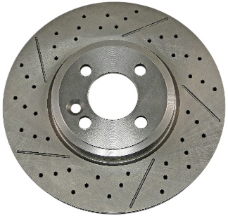
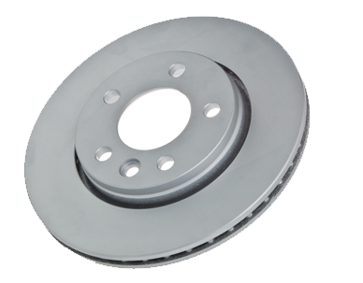
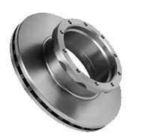
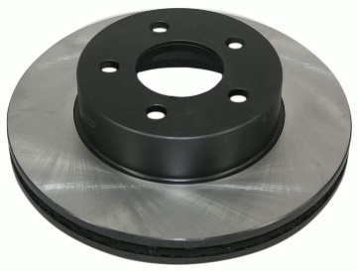
PRODUCT CATEGORY
Heyi Auto Parts
Product Type | PV Brake Disc | Brake Drum | Performance Disc | Painted Disc | Coated Disc | CV Disc
Picture
Material | According to G11H18(Previous G3000), GG20, GG15HC or customers’ requirement
Product Advantages
Finished, balanced, ready to install (no turning required)
Match OE in form, fit and function
Bearings included where required

Slide 6
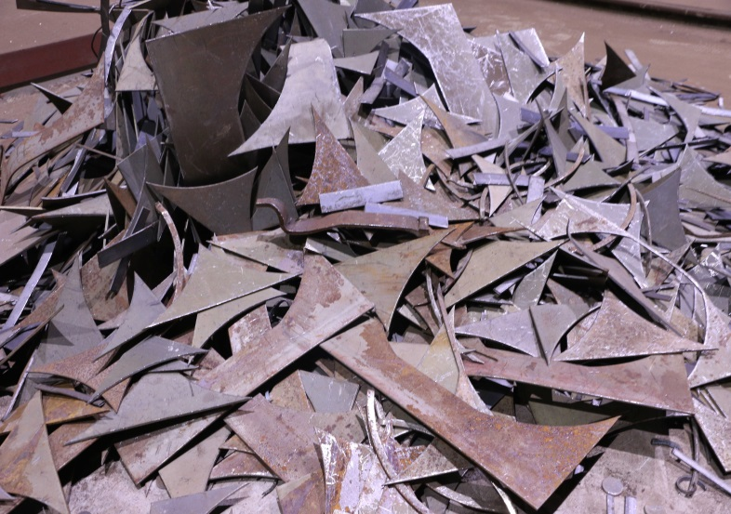
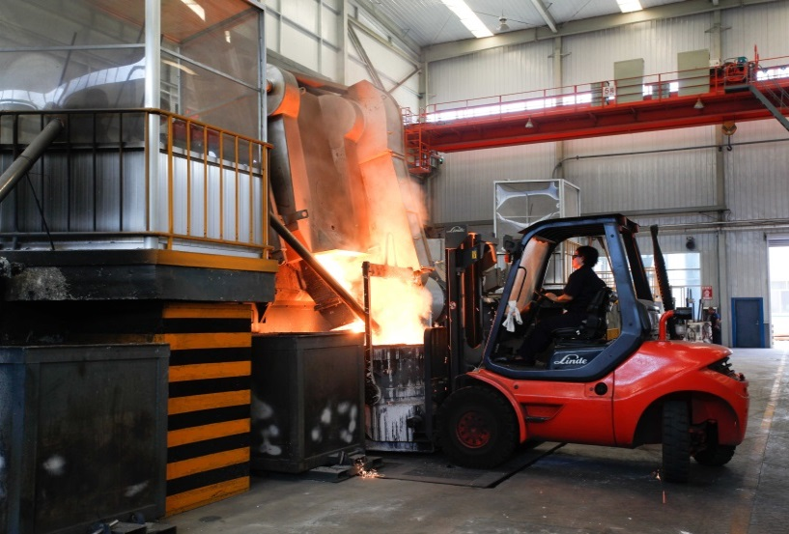
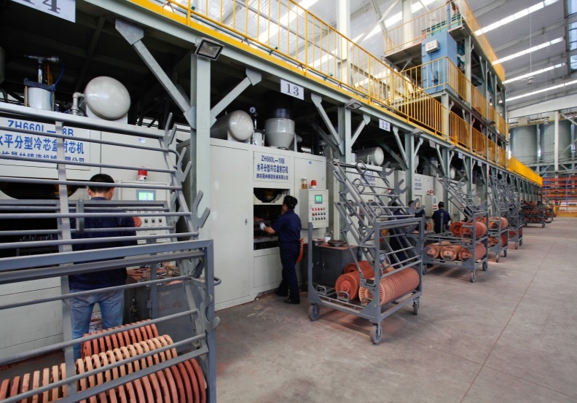
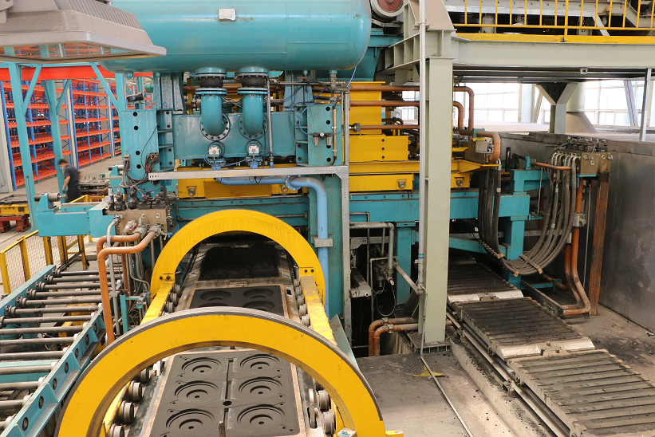
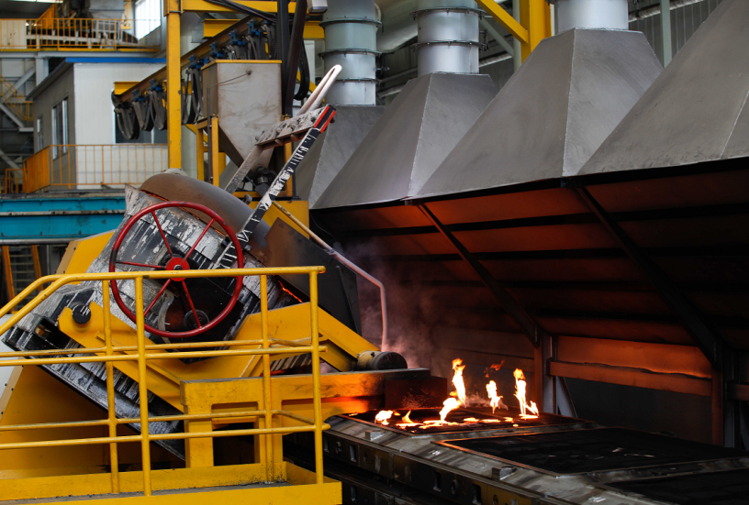
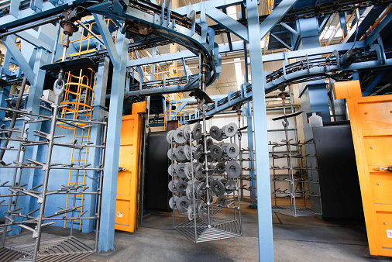
FOUNDRY WORKSHOP
Heyi Auto Parts
Raw Material
6T Electric Furnace
Sand Core Making
Automated Molding Line
Automated pouring
Sand Blasting
Copyright @ 2019 Heyi, all right reserved

Slide 7
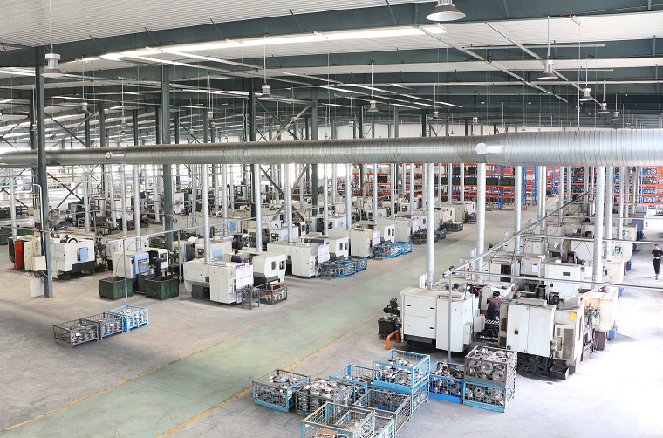
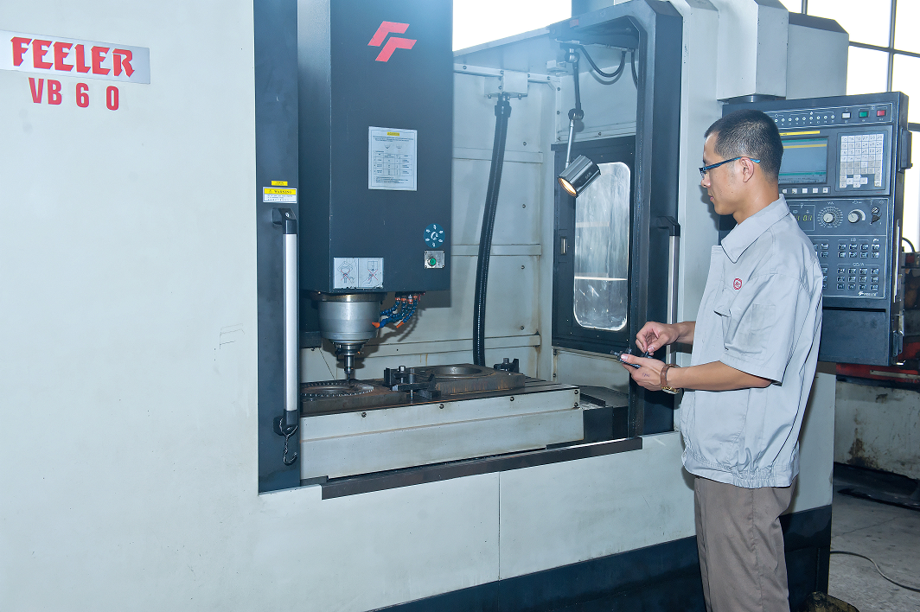
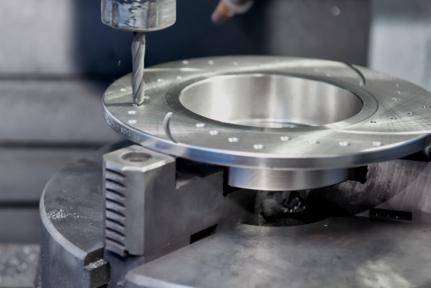
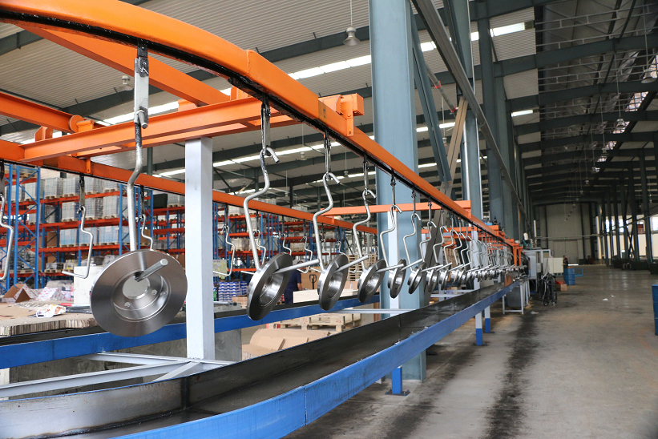
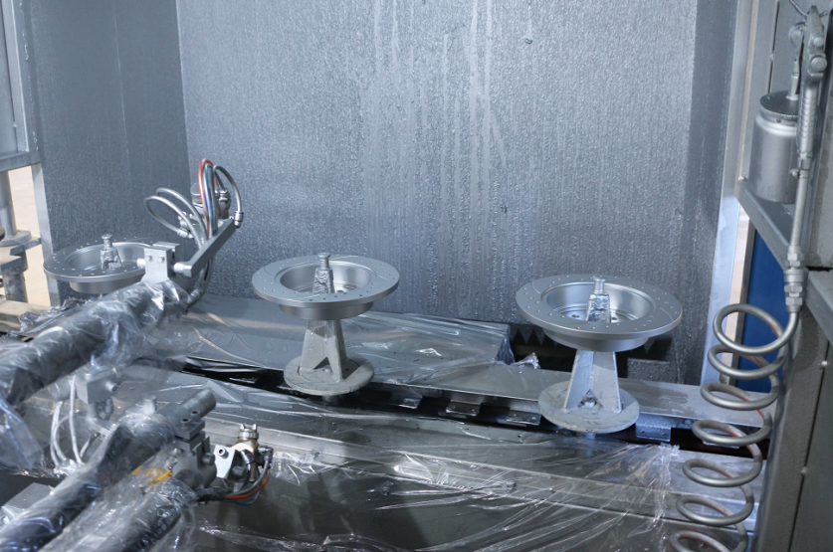
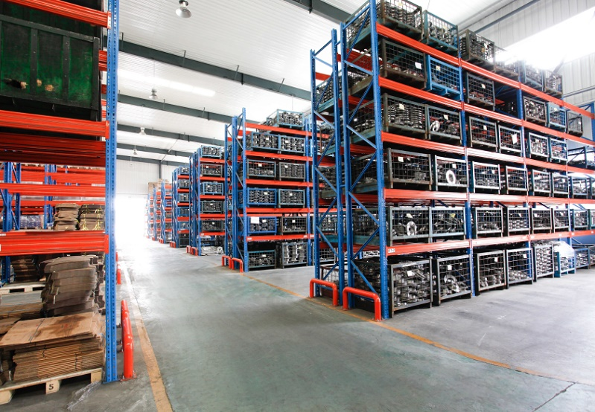
MACHINING WORKSHOP
Heyi Auto Parts
Machining Workshop
Precise machine
Drilling & Slotting
Cleaning line
Automated coating
Warehouse & Stocking
Copyright @ 2019 Heyi, all right reserved

Slide 8
QUALITY CONTROL
Heyi Auto Parts
New Part Number Development
Reliable sample source
OEM samples or OEM background customer drawings
Accurate dimensions and weight measurement
No lightweight or installation risk
Casting
Chemical analysis
Metallographic analysis
Hardness and tensile strength etc.
Products
Appearance check, sand holes, below holes, shrinkage, cold traps etc.
Full dimensional inspection
DTV, Runout and Balance test etc.
Copyright @ 2019 Heyi, all right reserved

Slide 9
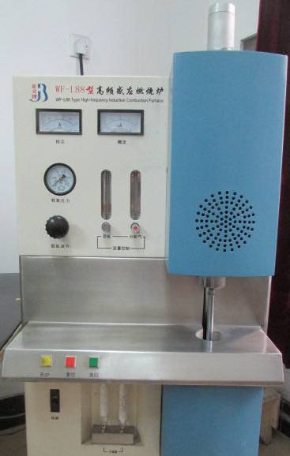
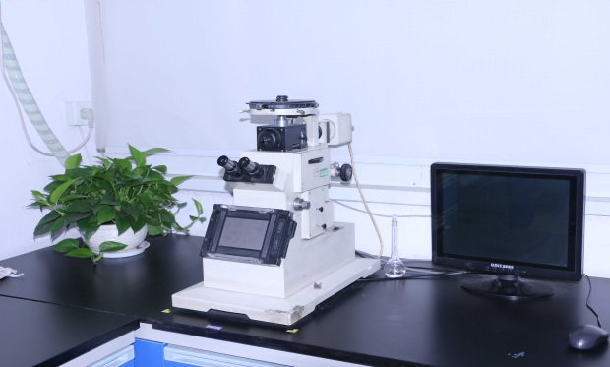
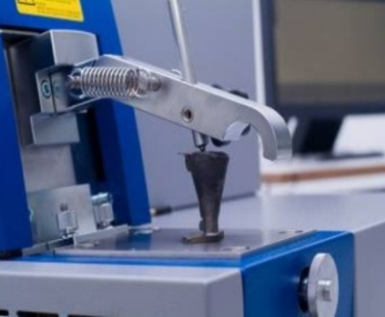
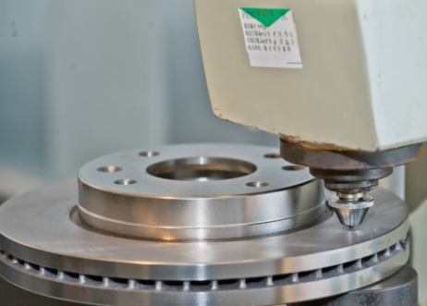
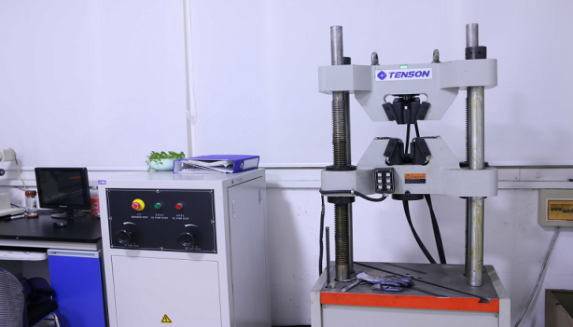
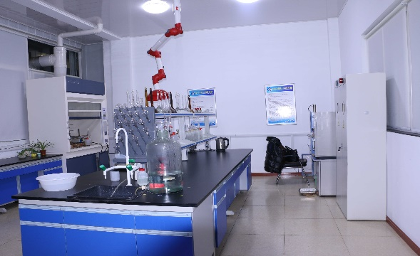
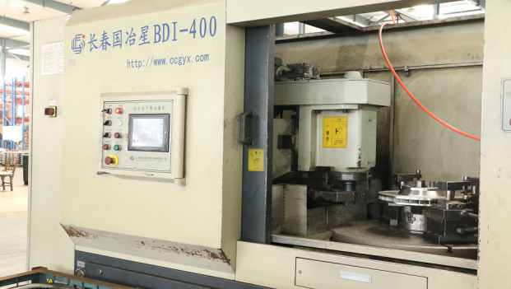
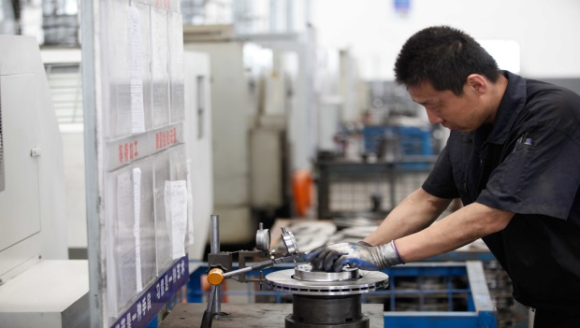
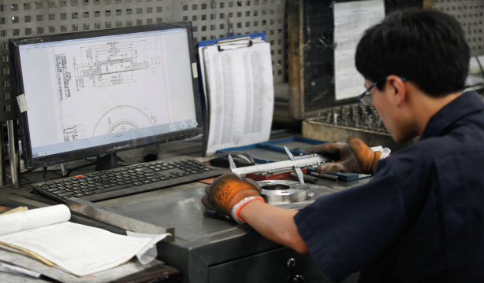
QUALITY INSPECTION
Heyi Auto Parts
C & S Analyzer
Microstructure
Spectrometer
Hardness
Tensile Strength
Chemical Lab
Automated Balancing
Online inspection
Final inspection
Copyright @ 2019 Heyi, all right reserved

Slide 10
MARKET CONTRIBUTION
Heyi Auto Parts
Europe 65%
North America
30%
All Others 5%
文本
Copyright @ 2019 Heyi, all right reserved

Slide 11
WHY CHOOSE US?
Heyi Auto Parts
Comprehensive category of
over 3000 references
State-of-the-art equipment to guarantee precise production
Fast development ability (2 weeks)
& rigorous quality control
Excellent cost control ability
Steady lead time and prompt aftersales service
Professional team for efficient communication
Keeping improving and standardizing our process
Willing to accommodate customers’ special requirements
Copyright @ 2019 Heyi, all right reserved

Slide 12
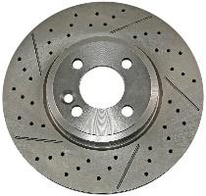
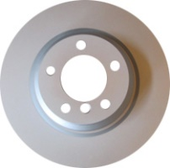
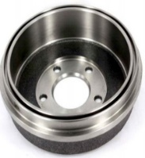
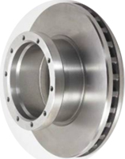
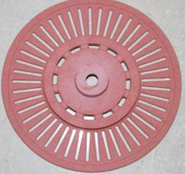
THANK YOU!
Web: www.heybrakes.com
Tel.: 86 535 5137957
Mobile: 86 15006450639
Email: zhumingyang@hcjixie.cn
Copyright @ 2019 Heyi, all right reserved

